Slide 1
Digital Portfolio
STUDENT NAME: Abhisree B
REGISTER NO:24bsai102
NMID:4C363DE6CFD423B09220407E646655DACB
DEPARTMENT: B.Sc.,ARTIFICIAL INTELLIGENCE AND MACHIN LEARNING
COLLEGE: SRI KRISHNA ADITHYA COLLEGE OF ARTS AND SCIENCE
UNIVERSITY:BHARATHIYAR UNIVERSITY

Slide 2
PROJECT TITLE
MY PORTFOLIO

Slide 3


AGENDA
Problem Statement
Project Overview
End Users
Tools and Technologies
Portfolio design and Layout
Features and Functionality
Results and Screenshots
Conclusion
Github Link
3/21/2024 Annual Review

Slide 4

PROBLEM STATEMENT
Build a responsive personal portfolio website titled My Portfolio to showcase my profile, projects and contact details.
Provide a simple, professional online resume and project showcase for internships and interviews.

Slide 5

PROJECT OVERVIEW
Single-page responsive site using HTML, CSS, JavaScript.
Sections: Header (Hello + intro + View My Work), Centered About Me (profile photo + AI/ML student lines), Projects (3 cards), Contact form (prefilled), Footer.

Slide 6
End Users
Recruiters & employers — quickly review profile and projects.
Project guides & faculty — assess academic work.
Peers & collaborators — learn about skills and contact info.
Self — digital resume for applications and interviews.

Slide 7

TOOLS AND TECHNIQUES
HTML5 — page structure
CSS3 — responsive layout & styling
JavaScript — smooth scroll, form validation & footer year
CodePen — rapid development and live preview
Image hosting (i.ibb.co) — profile picture

Slide 8
POTFOLIO DESIGN AND LAYOUT
Clean hero header with title and View My Work button.
Centered About Me with round profile photo and two-line AI/ML student description.
Projects section with three horizontal cards: Online Voting System, My Portfolio, Stress Management Sensor.
Contact section: vertical single-field inputs (Name, Email, Phone) and Send button.
Footer with current year.
8

Slide 9
FEATURES AND FUNCTIONALITY
Responsive design (desktop & mobile).
Smooth scroll navigation to Projects.
Pre-filled contact form fields (Name: Mugesh S; Email & Phone provided).
Client-side validation and demo submission.
Lightweight, clean, and easy to extend.

Slide 10
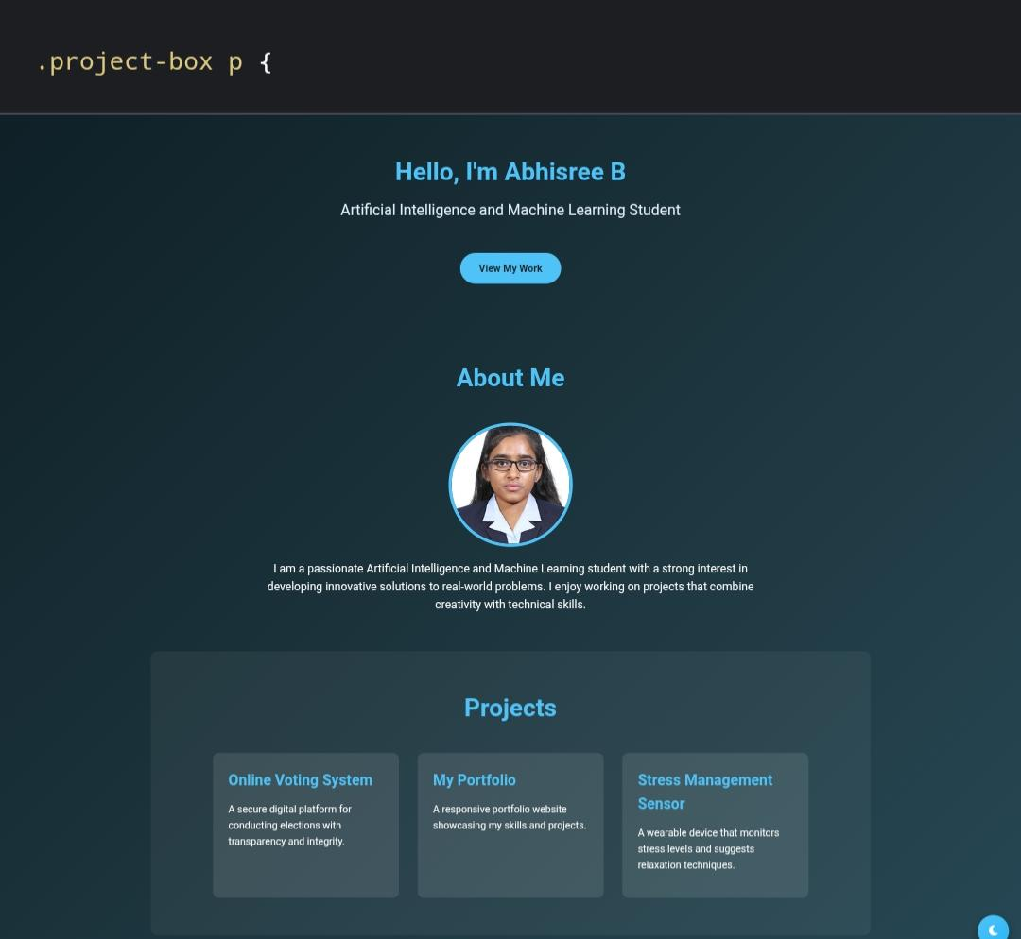

RESULTS AND SCREENSHOTS
3/21/2024 Annual Review
10

Slide 11
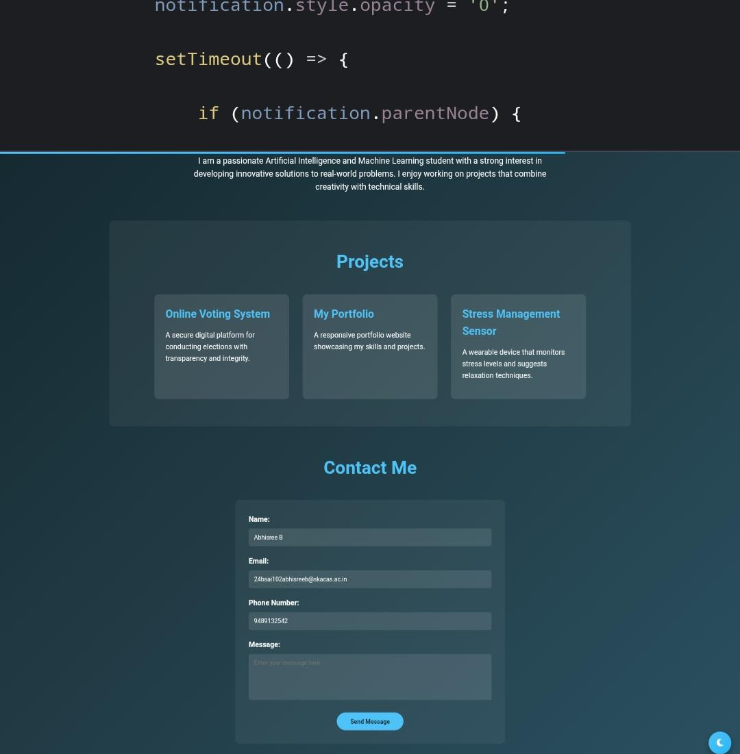

Slide 12
CONCLUSION
Completed a professional portfolio website that highlights profile and projects.
Next steps: add project pages or live demos, connect a backend or email service to receive messages, add GitHub & LinkedIn links.
12

